Slide 1
Popular open-source libraries for Deep Learning
Dr. Rajeshri Shinkar
Asst. Prof.

Slide 2
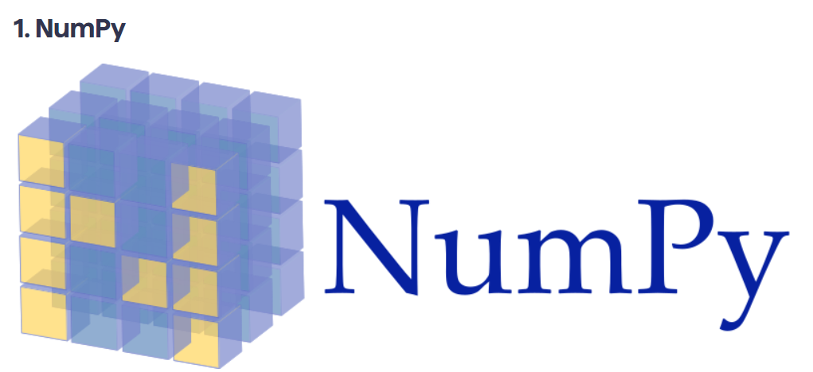
NumPy is an open-source numerical and popular Python library.
It can be used to perform a variety of mathematical operations on arrays and matrices.
It is one of the most used scientific computing libraries, and it’s often used by scientists for data analysis. Additionally, its ability to process multidimensional arrays—handling linear algebra and Fourier transformation.

Slide 3
Compared with regular Python lists, NumPy arrays require significantly less storage area.
They’re also much faster and more convenient to use than the former.
NumPy allows you to manipulate the data in the matrix and to transpose and reshape it.
Compiled, Numpy’s capabilities help you improve the performance of your machine learning model without much hassle.

Slide 4
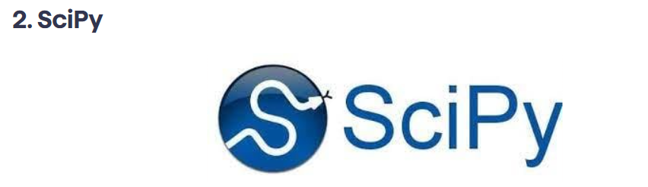
SciPy is a free and open-source library that’s based on NumPy.
It can be used to perform scientific and technical computing on large sets of data. Similar to NumPy, SciPy comes with embedded modules for array optimization and linear algebra. It’s considered a foundational Python library due to its critical role in scientific analysis and engineering.
*SciPy depends greatly on NumPy for its array manipulation subroutines and includes all of NumPy’s functions. However, it adds to them to make them full-fledged scientific tools that are still user-friendly.
SciPy is ideal for image manipulation and provides basic processing features of non-scientific high-level mathematical functions.
* It’s easy to use and fast to execute. It also includes high-level commands that play a role in data visualization and manipulation.

Slide 5
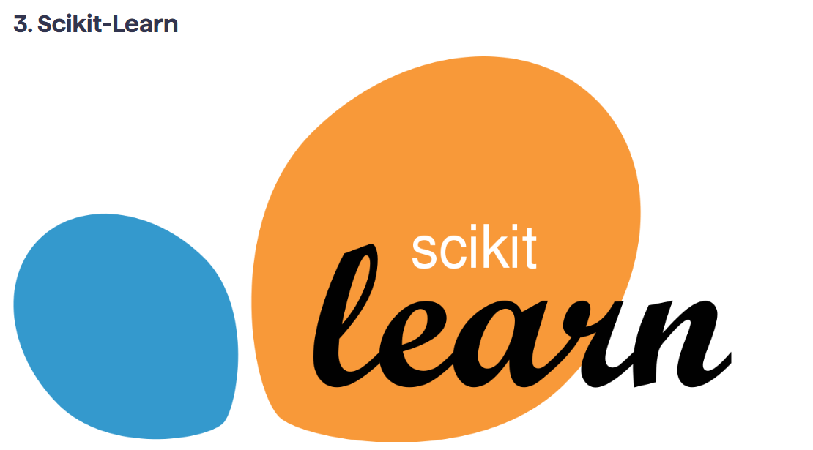
Based on NumPy and SciPy, scikit-learn is a free Python library that’s often considered a direct extension of SciPy.
It was specifically designed for data modeling and developing machine learning algorithms, both supervised and unsupervised.
It is simple, intuitive, and consistent interface, scikit-learn is both beginner and user-friendly.
Although the use of scikit-learn is limited because it only excels in data modeling, it does an excellent job at allowing users to manipulate and share data however they need.

Slide 6
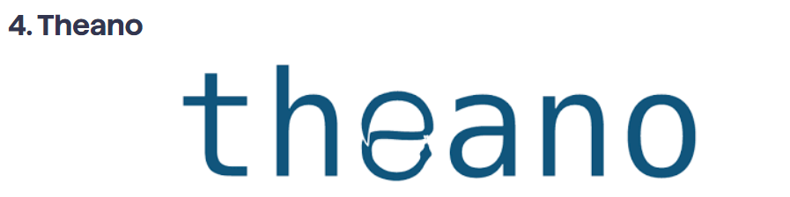
Theano is a numerical computation Python library made specifically for machine learning.
* It allows for efficient definition, optimization, and evaluation of mathematical expressions and matrix calculations to employ multidimensional arrays to create deep learning models.
* It’s a highly specific library and almost exclusively used by ML and DL developers and programmers.
Theano supports integration with NumPy, and when used with a graphics processing unit (GPU) rather than a central processing unit (CPU), it performs data-intensive computations 140 times faster.
Additionally, Theano has built-in validation and unit testing tools to avoid bugs and errors later on in the code.

Slide 7
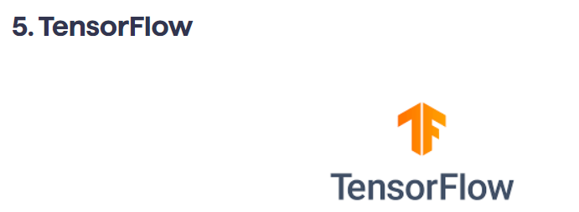
* TensorFlow is a free and open-source Python library that specializes in differentiable programming.
The library offers a collection of tools and resources that help make building DL and ML models and neural networks straightforward for beginners and professionals.
TensorFlow’s architecture and framework are flexible and allow it to run on several computational platforms such as CPU and GPU. However, it performs its best when working on a tensor processing unit (TPU).
* TensorFlow can be used to implement reinforcement-learning in ML and DL models and allows you to directly visualize your machine learning models with its built-in tools. TensorFlow isn’t limited to working on desktop devices. It lets you create and train smart models on servers and smartphones.

Slide 8
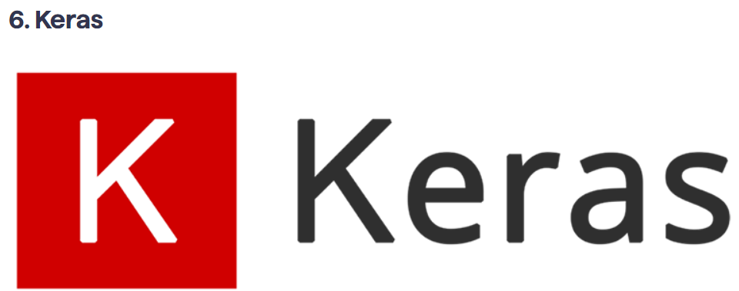
Keras is an open-source Python library designed for developing and evaluating neural networks within deep learning and machine learning models.
It can run on top of Theano and TensorFlow, making it possible to start training neural networks with a little code.
The Keras library is modular, flexible, and extensible, making it beginner- and user-friendly. It also offers a fully functioning model for creating neural networks as it integrates with objectives, layers, optimizers, and activation functions.
Keras framework is flexible and portable, allowing it to operate in multiple environments and work on both CPUs and GPUs.
It allows for fast and efficient prototyping, research work, and data modeling and visualization. Keras also has one of the widest ranges when it comes to data types because it can work on text images and images to train models.

Slide 9

Keras is an open-source library that provides a Python interface for artificial neural networks. Keras acts as an interface for the TensorFlow library.
What is Keras used for?
Keras is a high-level, deep learning API developed by Google for implementing neural networks. It is written in Python and is used to make the implementation of neural networks easy. It also supports multiple backend neural network computation.

Slide 10

PyTorch is an open-source machine learning Python library that’s based on the C programming language framework, Torch.
PyTorch qualifies as a data science library and can integrate with other similar Python libraries such as NumPy. It’s able to seamlessly create computational graphs that can be changed anytime while the Python program is running.
It’s mainly used in ML and DL applications such as computer vision and natural language processing.
PyTorch is known for its high speeds of execution even when it’s handling heavy and extensive graphs.
It’s also highly flexible, which allows it to operate on simplified processors in addition to CPUs and GPUs.
PyTorch comes with a collection of powerful APIs that lets you expand on the PyTorch library, as well as a natural language toolkit for smoother processing. It’s compatible with Python’s IDE tools, which makes for an easy debugging process.

Slide 11

PyTorch is a fully featured framework for building deep learning models, which is a type of machine learning that's commonly used in applications like image recognition and language processing. Written in Python, it's relatively easy for most machine learning developers to learn and use.

Slide 12

Pandas is a data science and analysis Python library that allows developers to build intuitive and seamless high-level data structures.
Built on top of NumPy, Pandas is responsible for preparing data sets and points for machine training. Pandas uses two types of data structures, one-dimensional (series) and two-dimensional (DataFrame), which, together, allow Pandas to be used in a variety of sectors, from science and statistics to finance and engineering.
The Pandas library is flexible and can be used in tandem with other scientific and numerical libraries.
Its data structures are easy to use because they’re highly descriptive, quick, and compliant. With Pandas, you can manipulate data functionality by grouping, integrating, and re-indexing it using minimal commands.

Slide 13
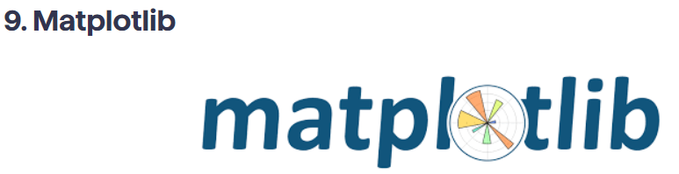
Matplotlib is a data visualization library that’s used for making plots and graphs.
It’s an extension of SciPy and is able to handle NumPy data structures as well as complex data models made by Pandas.
Although its expertise is limited to 2D plotting, Matplotlib can produce high-quality and publish-ready diagrams, graphs, plots, histograms, error charts, scatter plots and bar charts.
Matplotlib is intuitive and easy to use, making it a great choice for beginners.
It’s even easier to use for people with preexisting knowledge in various other graph-plotting tools. It offers GUI toolkit support, including wxPython, Tkinter, and Qt.

Slide 14
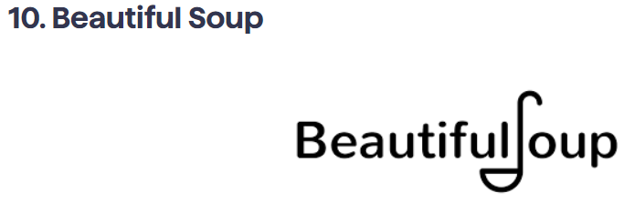
Beautiful Soup is a Python package used for web scraping and data collection that parses XML and HTML documents and prepares them for manipulation.
It creates a parse tree for all the parsed pages of a website that can then be used to seamlessly extract the web content’s data from HTML. Thanks to its versatility and the type of data it’s able to scrape, Beautiful Soup is used by data scientists and analysts as well as by ML and DL developers looking for data to train their programs.
Beautiful Soup is incredibly fast and efficient at doing its job and doesn’t require extensive hardware resources to function. It’s extremely lenient and works with a variety of websites and encoded data types.
Beautiful Soup is easy to use even for absolute Python beginners thanks to its simplistic code, comprehensive documentation, and active online community.

Slide 15
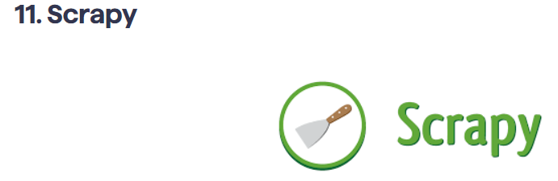
Scrapy is a free and open-source web scraping Python library. It’s designed for large-scale web scraping.
It comes included with all the tools needed to extract data from websites and process them into use-ready states. In addition to web scraping and crawling,
Scrapy also allows you to use APIs to extract data directly from websites that offer it.
One of Scrapy’s biggest advantages is its incredible data scraping speeds in relation to its efficient CPU and memory use.
Scrapy’s spiders make parallel requests to the website and don’t have a long wait line. In addition to being easily extendable, Scrapy is extremely beginner- and user-friendly thanks to its strong community of developers and sufficient documentation.

Slide 16
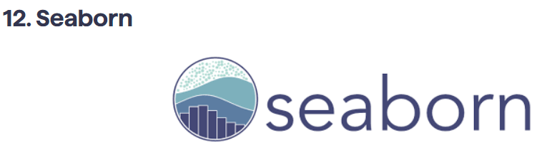
Seaborn is an open-source data visualization and plotting Python library. It’s based on the plotting library Matplotlib and includes the extensive data structures of Pandas.
Seaborn provides a high-level and feature-heavy interface to draw accurate and informative statistical graphs. It’s used in ML and DL projects because of its ability to generate sensible plots of learning and execution data.
Seaborn produces the most visually appealing and attractive graphs and plots, making it perfect for use in publications and marketing.
Additionally, Seaborn allows you to create extensive graphs with little code and simple commands, so it can help save time and effort on your behalf.

Slide 17
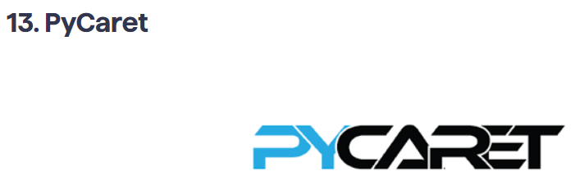
PyCaret is an open-source Python machine learning library that’s based on the Caret machine learning library written in R. PyCaret offers features that automate and simplify standard practices and ML programs.
It allows ML developers to spot-check a myriad of standard ML and DL algorithms on a classification or regression data set with a single command.
PyCaret is moderately easy to use even though there’s a learning curve. It’s important to note that PyCaret is low-code, which makes it a low-energy and efficient library to use.
In addition to its ability to compare different machine learning models for you, PyCaret has simple commands or basic data processing and feature engineering.

Slide 18
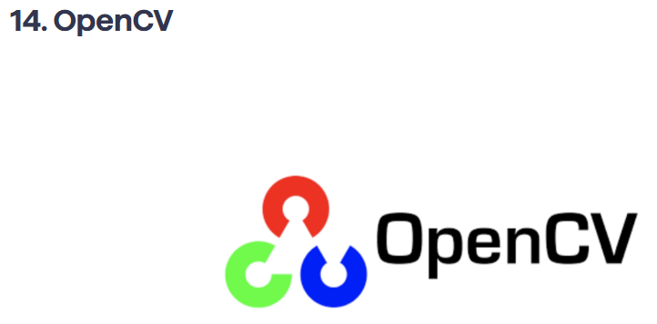
OpenCV is a library consisting of various programming functions, which makes it useful for real-time computer vision programs.
It’s able to process a variety of visual inputs from image and video data and identify objects, faces, and handwriting.
OpenCV was designed with computational efficiency in mind.
The library takes full advantage of its multicore processing functions to allow for a strong focus on real-time data processing in applications. It also has a supportive and active online community that keeps it going.

Slide 19
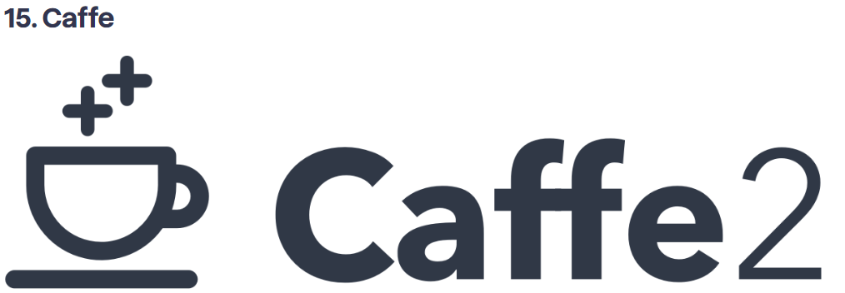
Caffe is an open-source deep-learning library and framework that’s written in C++ with a Python interface.
Caffe stands for Convolutional Architecture for Fast Feature Embedding. It has valuable applications in academic research and startup prototyping and large-scale, industrial applications in AI, computer vision, and multimedia.
Caffe has an expressive architecture, allowing you to define and optimize your models without relying on complex code.
It also allows for smooth switching between CPUs and GPUs, training machines on a GPU, and then deploying them on a variety of devices and environments. Caffe has the capacity to process over 60 million images per day, making it perfect for undetermined experiments and scaled industry deployment.

Slide 20
References:
https://www.springboard.com/blog/data-science/python-libraries-for-machine-learning/

